Slide 1
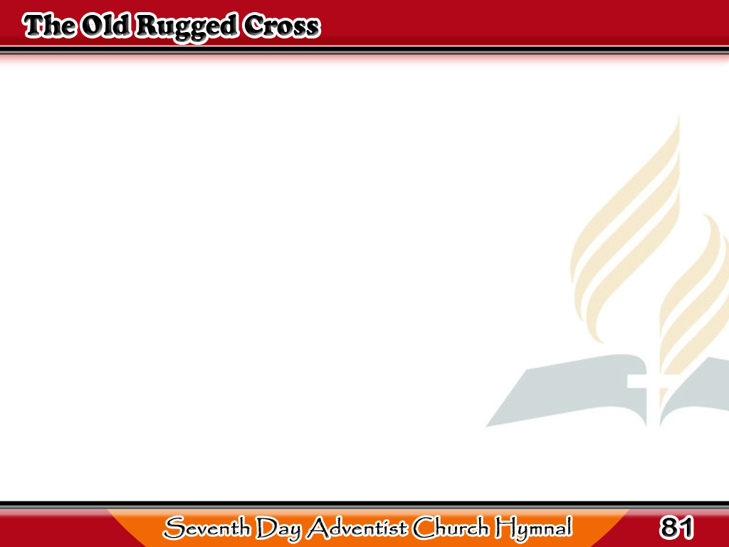
Sa Tuktok ng Isang Gulod
On a hill far away stood
an old rugged cross,
The emblem of suffering
and shame,
1/3

Slide 2
Sa Tuktok ng Isang Gulod
And I love that old cross
where the dearest and best,
For a world of lost sinners
was slain.
1/3

Slide 3
Sa Tuktok ng Isang Gulod
-Refrain-
So I’ll cherish
the old rugged cross,
Till my trophies at last
I lay down;
1/3

Slide 4
Sa Tuktok ng Isang Gulod
-Refrain-
I will cling to the
old rugged cross,
And exchange it some day
for a crown.
1/3

Slide 5
Sa Tuktok ng Isang Gulod
Oh, that old rugged cross,
so despised by the world,
Has a wondrous
attraction for me,
2/3

Slide 6
Sa Tuktok ng Isang Gulod
For the dear Lamb of God
left His glory above,
To bear it to dark Calvary.
2/3

Slide 7
Sa Tuktok ng Isang Gulod
-Refrain-
So I’ll cherish the
old rugged cross,
Till my trophies at last
I lay down;
2/3

Slide 8
Sa Tuktok ng Isang Gulod
-Refrain-
I will cling to the
old rugged cross,
And exchange it some day
for a crown.
2/3

Slide 9
Sa Tuktok ng Isang Gulod
To the old rugged cross
I will ever be true,
Its shame and reproach
gladly bear;
3/3

Slide 10
Sa Tuktok ng Isang Gulod
Then He’ll call me some
day to my home far away,
Where His glory for ever
I’ll share.
3/3

Slide 11
Sa Tuktok ng Isang Gulod
-Refrain-
So I’ll cherish the
old rugged cross,
Till my trophies at last
I lay down;
3/3

Slide 12
Sa Tuktok ng Isang Gulod
-Refrain-
I will cling to the
old rugged cross,
And exchange it some day
for a crown.
3/3

